Slide 1
Dr. Yifeng Zhu Electrical and Computer Engineering University of Maine
Embedded Systems with ARM Cortex-M Microcontrollers in Assembly Language and C
Chapter 13
Instruction Encoding and Decoding
Spring 2020

Slide 2
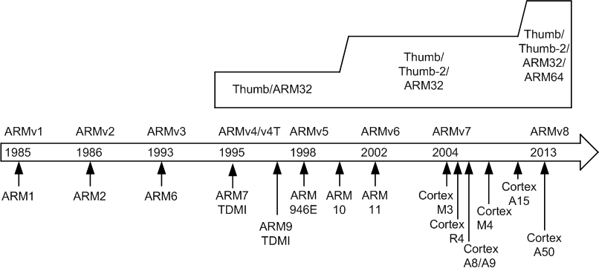
History

Slide 3
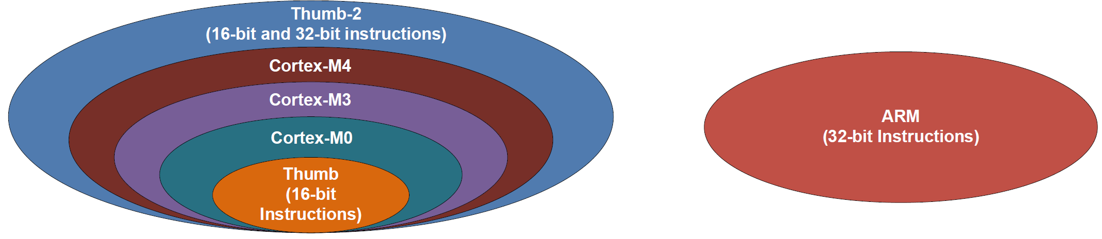
Instruction Sets

Slide 4
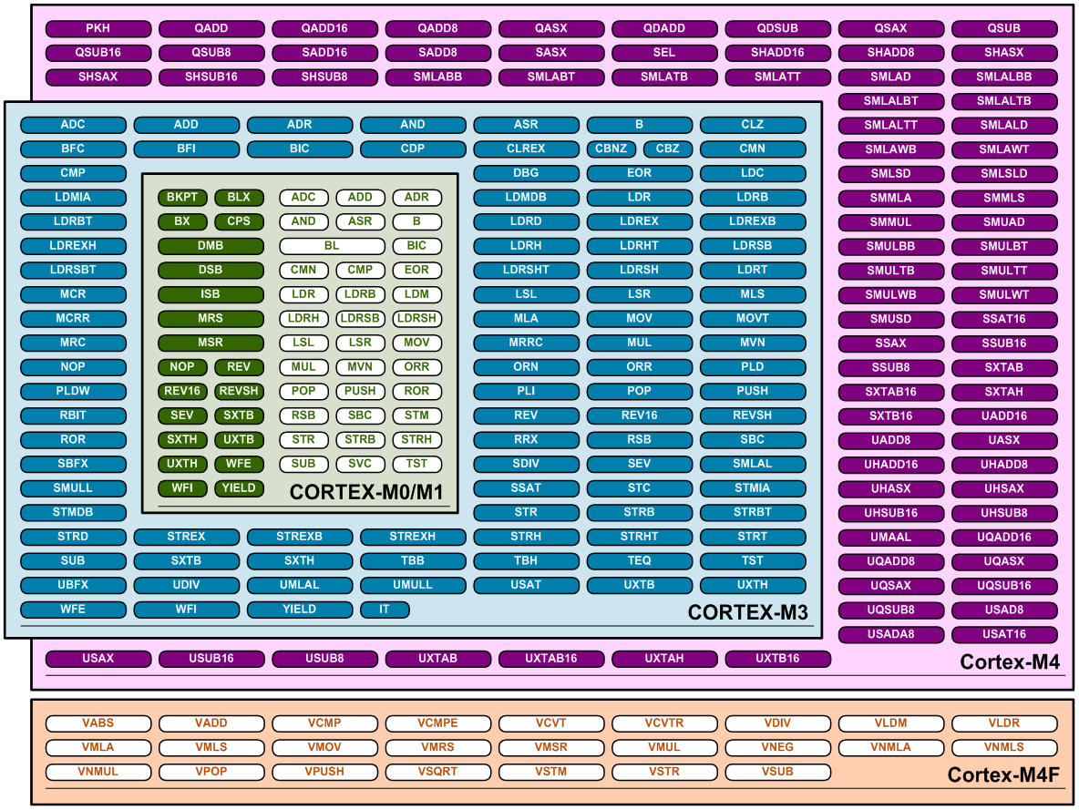
Instruction Sets
from arm.com

Slide 5
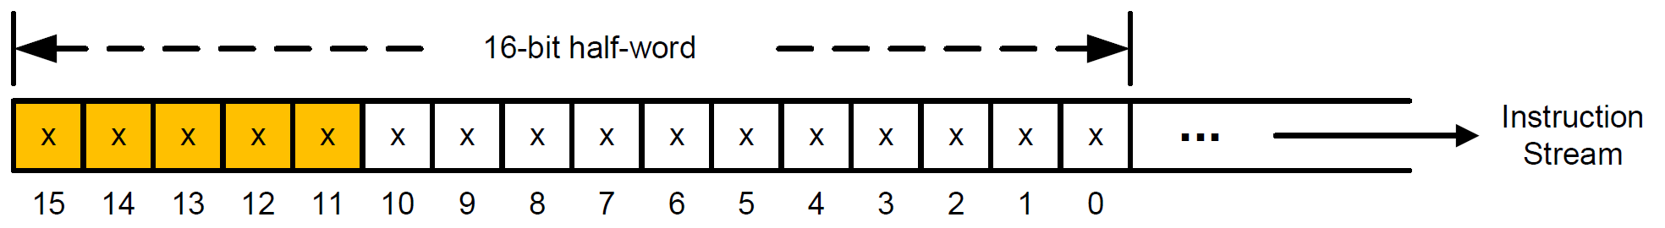
Dividing Bit Stream Into Thumb Instructions
For Thumb Instructions:
Check bit [15-11]:
If bit [15-11] = 11101, 11110, or 11111,
⟹ first half-word of a 32-bit instruction. Otherwise, a 16-bit instruction.

Slide 6
Encoding 16-bit Thumb Instructions
15 | 14 | 13 | 12 | 11 | 10 | 9 | 8 | 7 | 6 | 5 | 4 | 3 | 2 | 1 | 0
0 | 0 | minor opcode |  |  |  |  |  |  |  |  |  |  |  |  |  | Shift, add, subtract, move, & compare
0 | 1 | 0 | 0 | 0 | 0 | minor opcode |  |  |  | Rm/Rn |  |  | Rd/Rn |  |  | Data processing
0 | 1 | 0 | 0 | 0 | 1 | minor opcode |  |  |  | Rm |  |  | Rd/Rn |  |  | Special data instructions & branch
0 | 1 | 0 | 0 | 1 | x | minor opcode |  |  |  |  |  |  |  |  |  | Load from Literal Pool
0 | 1 | 0 | 1 | x | x |  |  |  |  |  |  |  |  |  |  | Load/store single data item
0 | 1 | 1 | x | x | x |  |  |  |  |  |  |  |  |  |  | Load/store single data item
1 | 0 | 0 | x | x | x |  |  |  |  |  |  |  |  |  |  | Load/store single data item
1 | 0 | 1 | 0 | 0 | Rd |  |  | imm8 |  |  |  |  |  |  |  | Generate PC-relative address
1 | 0 | 1 | 0 | 1 | Rd |  |  | imm8 |  |  |  |  |  |  |  | Generate SP-relative address
1 | 0 | 1 | 1 | minor opcode |  |  |  |  |  |  |  |  |  |  |  | Miscellaneous 16-bit instructions
1 | 1 | 0 | 0 | 0 | Rd |  |  | register list |  |  |  |  |  |  |  | Store multiple registers
1 | 1 | 0 | 0 | 1 | Rd |  |  | register list |  |  |  |  |  |  |  | Load multiple registers
1 | 1 | 0 | 1 | minor opcode |  |  |  | offset-8 |  |  |  |  |  |  |  | Conditional branch, & supervisor call
1 | 1 | 1 | 0 | 0 | offset-11 |  |  |  |  |  |  |  |  |  |  | Unconditional branch

Slide 7
Encoding: ORR r1, r0
15 | 14 | 13 | 12 | 11 | 10 | 9 | 8 | 7 | 6 | 5 | 4 | 3 | 2 | 1 | 0
0 | 1 | 0 | 0 | 0 | 0 | 1 1 0 0 |  |  |  | 0 0 0 |  |  | 0 0 1 |  |  | ORR r1, r0
major opcode |  |  |  |  |  | minor opcode |  |  |  | Rn |  |  | Rd

Slide 8
Decoding: 0xF04F, 0x0003
 | 15 | 14 | 13 | 12 | 11 | 10 | 9 | 8 | 7 | 6 | 5 | 4 | 3 | 2 | 1 | 0
 | 1 | 1 | 1 | op1 |  | op2 |  |  |  |  |  | S
 |  |  |  |  |  | i
0xF04F | 1 | 1 | 1 | 1 0 |  | 0 | 0 | 0 0 1 0 |  |  |  | 0 | 1 1 1 1
 | 15 | 14 | 13 | 12 | 11 | 10 | 9 | 8 | 7 | 6 | 5 | 4 | 3 | 2 | 1 | 0
 | op | imm3 |  |  | Rd |  |  |  | imm8
0x0003 | 0 | 0 0 0 |  |  | 0 0 0 0 |  |  |  | 0 0 0 0 0 0 1 1

Slide 9
32-bit Thumb Instructions
31 | 30 | 29 | 28 | 27 | 26 | 25 | 24 | 23 | 22 | 21 | 20 | 19 | 18 | 17 | 16 | 15 | 14 | 13 | 12 | 11 | 10 | 9 | 8 | 7 | 6 | 5 | 4 | 3 | 2 | 1 | 0
1 | 1 | 1 | 0 | 1 | 0 | 0 | op |  | 0 | W | L | Rn |  |  |  | x |  | 0 | Register list |  |  |  |  |  |  |  |  |  |  |  |  | Load/store multiple
1 | 1 | 1 | 0 | 1 | 0 | 0 | op1 |  | 1 | op2 |  | Rn |  |  |  | x |  |  |  |  |  |  |  | op3 |  |  |  |  |  |  |  | Load/store dual or exclusive, table branch
1 | 1 | 1 | 0 | 1 | 0 | 1 | op |  |  |  | S | Rn |  |  |  | x | imm3 |  |  | Rd |  |  |  | imm2 |  |  |  | Rm |  |  |  | Data processing (shifted register)
1 | 1 | 1 | 0 | 1 | 1 | op1 |  |  |  |  |  |  |  |  |  | x |  |  |  | coproc |  |  |  |  |  |  | op |  |  |  |  | Coprocessor instructions
1 | 1 | 1 | 0 | 1 | x | 0 | op |  |  |  |  | Rn |  |  |  | 0 | imm3 |  |  | Rd |  |  |  | imm8 |  |  |  |  |  |  |  | Data processing (modified immediate)
1 | 1 | 1 | 1 | 0 | x | 1 | op |  |  |  |  | Rn |  |  |  | 0 |  |  |  |  |  |  |  |  |  |  |  |  |  |  |  | Data processing (plain binary immediate)
1 | 1 | 1 | 1 | 0 | op |  |  |  |  |  |  |  |  |  |  | 1 | op1 |  |  |  |  |  |  |  |  |  |  |  |  |  |  | Branches and miscellaneous control
1 | 1 | 1 | 1 | 1 | 0 | 0 | 0 | op1 |  |  | 0 |  |  |  |  | x |  |  |  | op2 |  |  |  |  |  |  |  |  |  |  |  | Store single data item
1 | 1 | 1 | 1 | 1 | 0 | 0 | op1 |  | 0 | 0 | 1 | Rn |  |  |  | Rt |  |  |  | op2 |  |  |  |  |  |  |  |  |  |  |  | Load byte, memory hints
1 | 1 | 1 | 1 | 1 | 0 | 0 | op1 |  | 0 | 1 | 1 | Rn |  |  |  | Rt |  |  |  | op2 |  |  |  |  |  |  |  |  |  |  |  | Load halfword, memory hints
1 | 1 | 1 | 1 | 1 | 0 | 0 | op1 |  | 1 | 0 | 1 | Rn |  |  |  | x |  |  |  | op2 |  |  |  |  |  |  |  |  |  |  |  | Load world
1 | 1 | 1 | 1 | 1 | 0 | 0 | x | x | 1 | 1 | 1 |  |  |  |  | x |  |  |  |  |  |  |  |  |  |  |  |  |  |  |  | Undefined
1 | 1 | 1 | 1 | 1 | 0 | 1 | 0 | op1 |  |  |  | Rn |  |  |  | x | 1 | 1 | 1 | 1 |  |  |  | op2 |  |  |  | Rm |  |  |  | Data processing (register)
1 | 1 | 1 | 1 | 1 | 0 | 1 | 1 | 0 | op1 |  |  |  |  |  |  | x | Ra |  |  |  |  |  |  | 0 | 0 | op2 |  | Rm |  |  |  | Multiply, multiply accumulate, and absolute difference
1 | 1 | 1 | 1 | 1 | 0 | 1 | 1 | 1 | op1 |  |  |  |  |  |  | x |  |  |  |  |  |  |  | op2 |  |  |  | Rm |  |  |  | Long multiply, long multiply accumulate, divide
1 | 1 | 1 | 1 | 1 | 1 | op1 |  |  |  |  |  |  |  |  |  | x |  |  |  | coproc |  |  |  |  |  |  | op |  |  |  |  | Coprocessor instructions

Slide 10
Decoding: 0xF04F, 0x0003
 | 15 | 14 | 13 | 12 | 11 | 10 | 9 | 8 | 7 | 6 | 5 | 4 | 3 | 2 | 1 | 0
 | 1 | 1 | 1 | op1 |  | op2 |  |  |  |  |  | S
 |  |  |  |  |  | i
0xF04F | 1 | 1 | 1 | 1 0 |  | 0 | 0 | 0 0 1 0 |  |  |  | 0 | 1 1 1 1
 | 15 | 14 | 13 | 12 | 11 | 10 | 9 | 8 | 7 | 6 | 5 | 4 | 3 | 2 | 1 | 0
 | op | imm3 |  |  | Rd |  |  |  | imm8
0x0003 | 0 | 0 0 0 |  |  | 0 0 0 0 |  |  |  | 0 0 0 0 0 0 1 1
MOV r0, #3

Slide 11
Encoding Immediate Integers
15 | 14 | 13 | 12 | 11 | 10 | 9 | 8 | 7 | 6 | 5 | 4 | 3 | 2 | 1 | 0
1 | 1 | 1 | op1 |  | op2 |  |  |  |  |  | S
 |  |  |  |  | i
15 | 14 | 13 | 12 | 11 | 10 | 9 | 8 | 7 | 6 | 5 | 4 | 3 | 2 | 1 | 0
op | imm3 |  |  | Rd |  |  |  | imm8
12-bit Immediate = i:imm3:imm8
It is not a normal 12-bit number!

Slide 12
Encoding Immediate Integers
i:imm3:imm8 | Value
0000abcdefgh | 00000000 00000000 00000000 abcdefgh
0001abcdefgh | 00000000 abcdefgh 00000000 abcdefgh
0010abcdefgh | abcdefgh 00000000 abcdefgh 00000000
0011abcdefgh | abcdefgh abcdefgh abcdefgh abcdefgh
01000bcdefgh | 1bcdefgh 00000000 00000000 00000000
01001bcdefgh | 01bcdefg h0000000 00000000 00000000
01010bcdefgh | 001bcdef gh000000 00000000 00000000
... | ...
11101bcdefgh | 00000000 00000000 000001bc defgh000
11110bcdefgh | 00000000 00000000 0000001b cdefgh00
11111bcdefgh | 00000000 00000000 00000001 bcdefgh0
8-bit values duplicated
8-bit values shifted
Example:
0xFF000000, i = 0, imm3 = 000, imm8 = 01111111=0x7F

